Slide 1
Food Insecurity in Durham
Trends & Responses
June 27, 2023
Community Care Durham
Annual General Meeting
Ben Earle, Chief Executive Officer
feedtheneedindurham.ca

Slide 2
Overview
Introduction and Overview of Feed the Need in Durham
Food Insecurity and Food Bank Use in Durham
Community and Policy Responses
Discussion

Slide 3
Community Food Distribution
Food Banks Canada (national association)
Feed Ontario (provincial association)
Feed the Need in Durham (regional food hub)
Community food programs
Food distribution for emergency food programs is managed collectively at a national level, to support coordinated responses to food procurement, distribution, advocacy, and planning

Slide 4
Feed the Need in Durham Vision
CORE VALUES
People and community first
Feed the Need in Durham puts people and community at the centre of all that we do.
Inclusion
Feed the need in Durham is an inclusive organization that strives to create an environment that is open and safe for all of those who seek our services, work with and for us, and who volunteer with us.
Accountability feed the need in Durham is open and accountable to donors, community partners and stakeholders, and to those we serve in the community.
Leadership
Feed the need in Durham stives to serve as a leader in the communities in which we operate, believing that through this leadership we can support innovation and sustainability in the delivery of food security programming and in the charitable sector.
Continuous learning
Feed the need in Durham engages in processes that support the ongoing expansion and reinforcement of learning to support improvement in our programming, services, and practice.
PURPOSE
To nourish our community
MISSION
FTND and its network of member organizations are recognized for their commitment to innovation and continuous improvement in their response to food insecurity and poverty in Durham through collaboration and collective impact

Slide 5
Overview of Feed the Need in Durham
Largest food security organization in Durham and one of the 10 largest food security organizations in Ontario
Distribute > 2 million pounds of food to 65 member network across Durham and through the Market Food Bank
Support innovation in food security programming through experiential learning
Working to create standards of practice to inform programming across Durham
Undertake relevant community-based action research

Slide 6
Feed the Need in Durham
Food Distribution
Food Banks
Community Connection & Development
Launch Pad Innovation Lab
The Market
Meal Programs
Neighbour Link
School Programs
Drop in Programs
Food Connect Levels 1-4
Chef's Pantry
Open Doors Shelter Program
Lunchbox Program
Supper Club Pre-Pack Program
Meal Program
Community Cupboards
Pantry Pre-Pack Program
Snack Program
Hub Share
Connection Programs
Research
Overview of Programs

Slide 7
Food Insecurity and Food Bank Use in Durham
How do we define food insecurity?
PROOF – University of Toronto Research Unit defines food insecurity as the inadequate or insecure access to food due to financial constraints (1). ​
This definition is constrained in scope and explanation​
SCOPE: food insecurity is the inadequate or insecure access to healthy, nutritious and/or appropriate food.
EXPLANATION: food insecurity is the result of market forces that have commodified food, leading to a lack of physical or economic access to food due to diverse and intersecting conditions, such as financial constraints, geography, and systemic discrimination and exclusion.
(1) https://proof.utoronto.ca/food-insecurity/

Slide 8
Food Insecurity and Food Bank Use in Durham
food insecurity in durham
14% of residents (approx. 94,462 individuals) report being food insecure in Durham. (2)
3.0%
Severe food insecurity
Missed meals, reduced intake, days without food
6.5%
Moderate food insecurity
Compromise in quality and/or quantity of food
4.3%
Marginal food insecurity
Worry about running out of food and/or limited food selection
(2) https://www.durham.ca/en/health-and-wellness/resources/Documents/HealthyLiving/PriceOfEatingWellInDurham.pdf

Slide 9
The hunger report provides a summary of the data gathered by Feed the Need in Durham’s service network through Link2Feed client intake system.
This data, collected between April 1st, 2021 through to March 31st, 2022, provides a picture of the use of food security programs in the community.
Launched in conjunction with Feed Ontario’s 2022 Hunger Report

Slide 10
Food Insecurity and Food Bank Use in Durham
Food bank use in durham (2021 – 2022)
48%
Increase in the number of individuals who accessed a food bank program
24,000 clients
58%
Increase in the number of visits to food banks
135,000 visits
25%
6,000 new clients
Of clients were first time food bank users

Slide 11
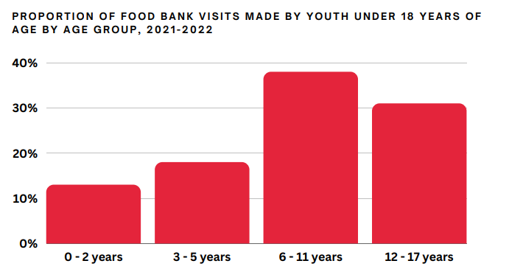
Food Insecurity and Food Bank Use in Durham
Food bank use in durham (2021 – 2022)
Of all food bank visits in 2021-2022, 38% were made by children and youth under the age of 18 years old who live in food insecure households.
Over 800 post-secondary students accessed a food bank in 2021-2022

Slide 12
Food Insecurity and Food Bank Use in Durham
Reasons given by clients for visiting a food bank
62% Rising cost of food
20% Housing costs
7%Declining wages

Slide 13
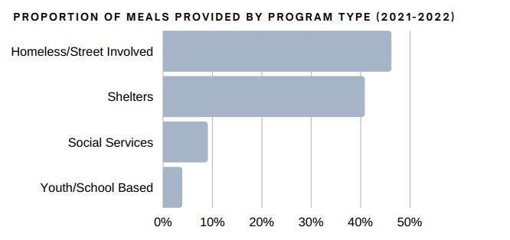
Food Insecurity and Food Bank Use in Durham
Meal program visits 2021-2022
344,761 visits to emergency meals/snack programs across Durham between April 1, 2021, and March 31, 2022.
68%
Increase compared to the previous year
87% of meals were provided to clients through programs targeted to those who are homeless, street involved or under houses.

Slide 14
Community and Policy Responses
Policy responses
Inadequate/insecure access to food...
Responses/Interventions that focus on food provision (FB)
Inadequate/insecure access to food due to financial constraints...
Responses/Interventions that focus on income security (SA reform, basic income)
Inadequate/insecure access to healthy, nutritious and/or appropriate food result of market forces that have commodified food, leading to a lack of physical or economic access to food due to diverse and intersecting conditions...
Responses that address current conditions of food insecurity, while examining the complex systemic issues that have led to a food system that allows for widespread food insecurity (food sovereignty, food as a commons
Food sovereignty (food as commons) - a food system in which the people who produce, distribute, and consume food also control the mechanisms and policies of food production and distribution. This stands in contrast to the present corporate food regime, in which corporations and market institutions control the global food system.
Indigenous perspectives on stewardship

Slide 15
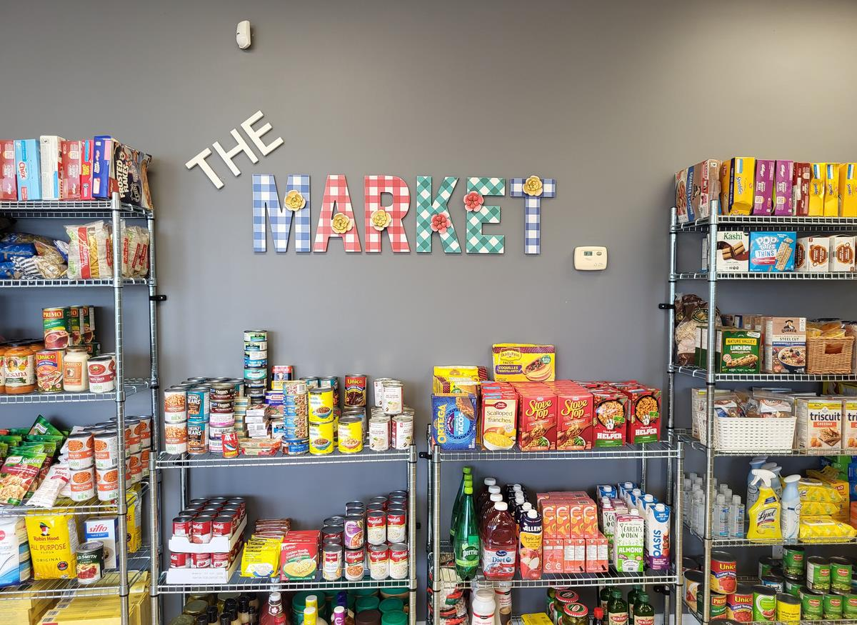
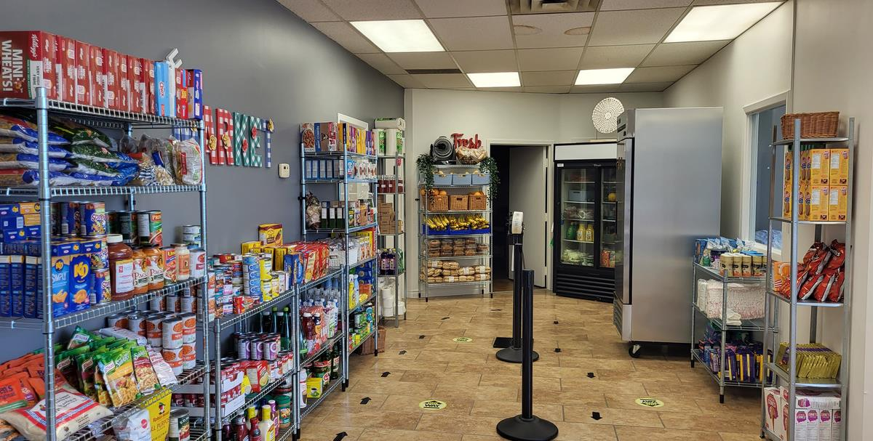
The Market
Feed the Need in Durham’s first on-site food bank, opened in Summer 2022
Created as a response to the shifting and growing client base in the community, providing emergency food support to help address gaps in service
Acts as a learning center for innovative approaches to food banking in the Durham Region

Slide 16
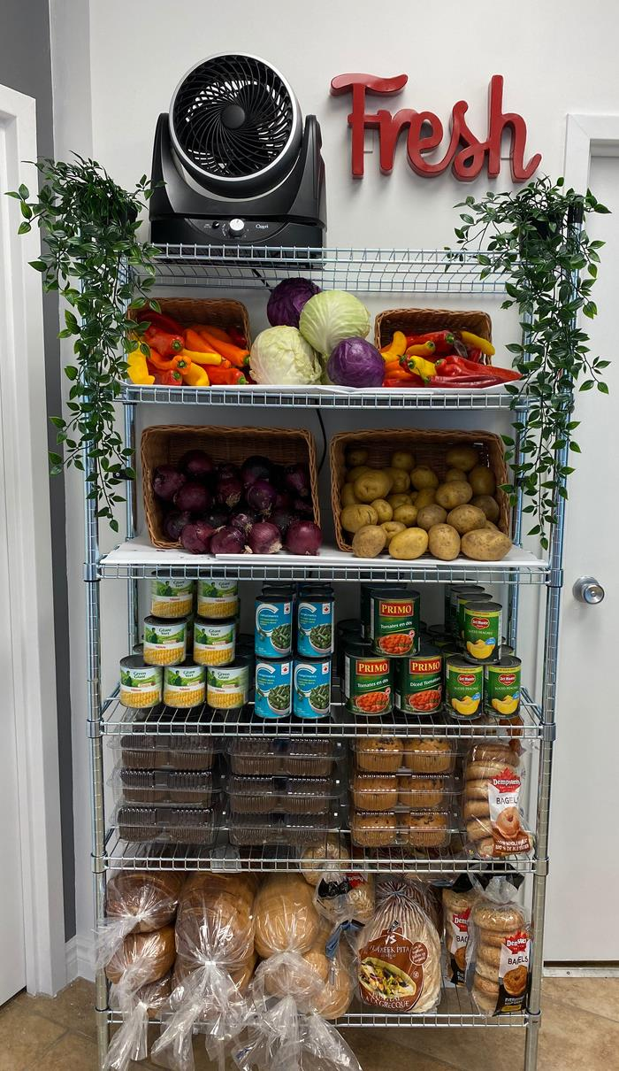
The Market
The Market is a shopping style food bank that is open every Tuesday from 3pm-6pm.
A random draw system is used to determine place in line, families are welcome to attend on a weekly basis.
Hand-held grocery baskets are used for shopping with the number of baskets determined based on family size.
With a few exceptions (fresh & frozen), clients can freely choose item based on their families needs, until their basket(s) is full.
Registration involves the collection of basic information which is used to understand needs, demographics and trends.
The goal is to change the face of food banking based on the shared principles of Dignity, Access and Abundance, through the provision of truly barrier free access to food in an inclusive, community-driven, environment.

Slide 17
Feed the Need and Community Care Durham
Alignment and Opportunities
Individually and collectively, as community organizations we face dynamic and increasingly complex and interconnected challenges; challenges that threaten the sustainability of our organizations and our community. More importantly, however, the clients that we serve are faced with challenges and struggles that are unprecedented in both their breadth and depth, including income and food insecurity exacerbated by rising costs of living, a housing crisis that has limited access to appropriate and affordable housing, and a crisis of mental health and abdications that has become a defining challenge in many parts of our community.
Community Care Durham | Feed the Need in Durham
Enhancing Client Quality of Life – provide comprehensive, person-centred and coordinated care | Programs are client centred and community driven
Investing in Our People – advance the knowledge and skills of our team | We are a people first organization, creating an environment where our staff and volunteers can thrive
Championing Healthy Communities – will lead and join collaborations that advance equity and healthy living | We are committed to community leadership and collaboration, believing that we can improve the lives of all those in our community if we work together to solve common problems and concerns
Building for Our Future – investing and building new, integrated and innovative approaches to programming and service | We are committed to innovation in food security and are launching a food insecurity innovation lab to create collaborative space for the development of new responses to the challenges faced by the communities that we serve.

Slide 18
Questions and Discussion
What do you think?
feedtheneedindurham.ca

